Slide 1

Machine Learning Driven Recognition and Smart Classification of Audios of Bharatanatyam Dance
By:- K.V.R.K.Vivek

Slide 2

What is the problem statement !?
We are given audio which is a periodic signal comprising of stick beating sound and the human voice (called as bols/syllables). There were no musical instruments used. We need to recognize and classify the audio. In the data set there are 6 set of audios which have 15 distinct audios.

Slide 3
Why are we doing this !?
Understanding the underlying semantics of performing arts like dance or music is a challenging task. Capturing and analyzing their multimedia content is useful for preservation of cultural heritage, to build recommendation systems, to assist learners use tutoring systems etc.
India has a rich tradition of classical dance. Bharatanatyam is one of the eight Indian classical dance forms.

Slide 4
In Bharatanatyam the dancer performs in sync with a specific form of structured rhythmic music, called Sollukattu.
Sollukattu is generated by instrumental strikes along with vocal utterance. It comprises of :-
Stick Beats: A Full Beat or 1-beat defines the basic unit of time. It is an instance on time scale generated by instrumental strikes.
Bols: It is the vocal utterance. It may accompany a stick beat.
Silence Beats: It is the period when there is nothing happening ,i-e, everything is silent.
The video part of the Bharatnatyam is called as Adavu.

Slide 5
How does the Dataset look like !?
Number of classes we have in our dataset are 15. These are namely Tatta, Natta, Utsanga, Tirmana, Tei Tei Dhatta, Sarika, Pakka, Paikkal, Joining, Katti/Kartari, Kuditta Nattal, Mandi, KudittaMettu, Kuditta Tattal, and Sarrikkal.
There are 6 sets of audios each which are sang by different people and in each set the same person is made to sing 3 times to get hold of the variations.

Slide 6
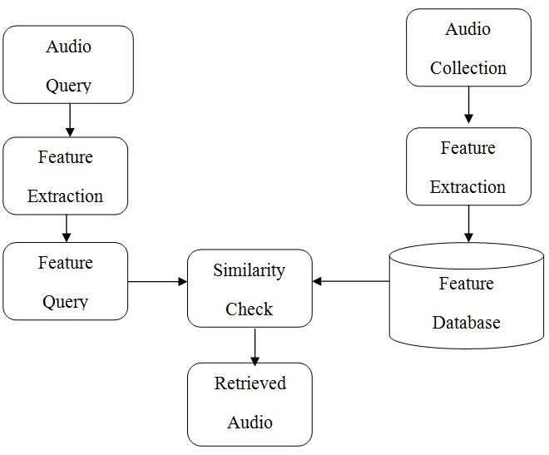
Each class has a unique bol sequence. The rules for composing a Sollukattu are defined in Bharatanatyam. The challenge, here, is to capture the rule set in the classifier and recognize an unknown Sollukattu using the trained classifier

Slide 7
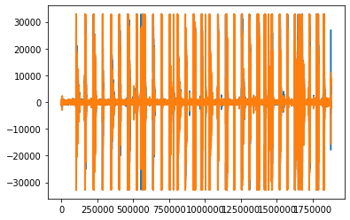
Now let’s analyse how a particular Sollukattu :- Natta looks like .
tei yum tat tat tei yum ta
Here is the amplitude vs time plot of the same.
We can notice how the signal
is spread across the time in
discrete patches. Those are the
points where bols/stick beats
occur.

Slide 8
Our Approach !
A brief outline of the approach that we are going to follow is :-
Split each song of each class to its bols .
Label each bol with its corresponding class.
Now each data point of a dataset consists of a sequence of bols labeled by its class.
We will use this data to train our model
Now let’s see each step in a much detailed way !

Slide 9
Splitting a song to its bols
Now we need to split the single audio file into multiple audio files such that they do not contain neither silence beats nor stick beats ! The approach we follow :-
Split the audio based on silence beats. So now we are left with small audio packets which may be pure stick beat, pure bol or a mixture of stick beat and bol.
The packet containing only stick beat is unnecessary for us and needs to be removed.
This can be done by checking the time period of the packet. Stick beats occur for a very small duration of time as compared to bols, hence we can remove the stick beats by keeping threshold on the time duration.

Slide 10
For splitting with respect to silence bits we will use the split_on_silence function from the pydub library which is as follows.
chunks=split_on_silence(song, min_silence_length, silence_threshold)
Where song is the audio file, min-silence_length is the silence length we require to consider it as silence, silence_threshold is the dB value which defines silence.
All the small parts of the original audio will be stored individually in
chunks

Slide 11
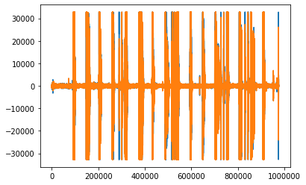
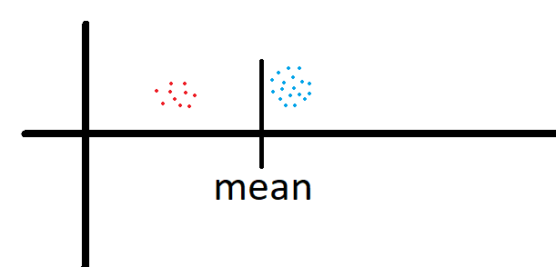
Now from the set of all chunks we need remove the chunk containing only stick beat.
Lets analyse the amplitude vs time curve for any Sollukattu. Eg:- Tattimettu
How to get the threshold ?
We will calculate the mean of the time periods of the chunks and remove all the chunks having time period less than that of the mean (stick beats).

Slide 12
So now, we have splitted the song into sound signals containing only bols or bols+stick beats .
Now we should convert the signal into a form (representation) which is suitable for training purposes, which implies we should extract features from the signal.
We will use the following features :-
Zero Crossing Rate
Spectral Centroid
MFCC - Mel Frequency Cepstral Coefficients
We will generate a high dimensional feature vector by combining them.
Now lets see what each feature describes !

Slide 13
Zero Crossing Rate :- The zero crossing rate is the rate of sign-changes along a signal ,i-e, the rate at which the signal changes from positive to negative or back.
Spectral Centroid :- It indicates where the centre of mass for a sound is located and is calculated as the weighted mean of the frequencies present in the sound.
MFCC :- The Mel Frequency Cepstral Coefficients(MFCCs) of a signal are a small set of features (usually 10-20 ) which concisely describe the overall shape of a spectral envelope.

Slide 14
Training the model
Now we have chunks of audio music labeled with the class which it belongs to and containing either bols or a mixture of bols and stick beats.
We can have two methods for training our model :-
Not preserving any sequence. Here we can use Machine Learning algorithms like XGBoost.
Preserving the sequence of the bols. Here we should use structures like LSTMs or HMM.

Slide 15
Using Machine Learning Algorithms
The perks of using this method are, since our original data set is small Machine Learning algorithms would be inefficient.
By using features of each bol as a datapoint, number of datapoints are more and hence algorithms would do good.
But the disadvantage is that we are not taking care of the ordering of bols in each Sollukattu .
( The algorithm which we would use is XGBoost which is known to give good results irrespective of dataset. Later we can change the algorithm if we find any better one ! )

Slide 16
Using LSTM ( Long Short-Term Memory )
Long Short-Term Memory (LSTM) Networks are a type of Recurrent Neural Network capable of learning order dependency in sequence prediction problems.
The steps we will follow to make our model is:
We will calculate the length of smallest Sollukattu, and trim all other Sollukattus to that length.
We will use the Keras library for implementing LSTM.
The disadvantage is that since the data we have is less, model maynot be trained properly.

Slide 17
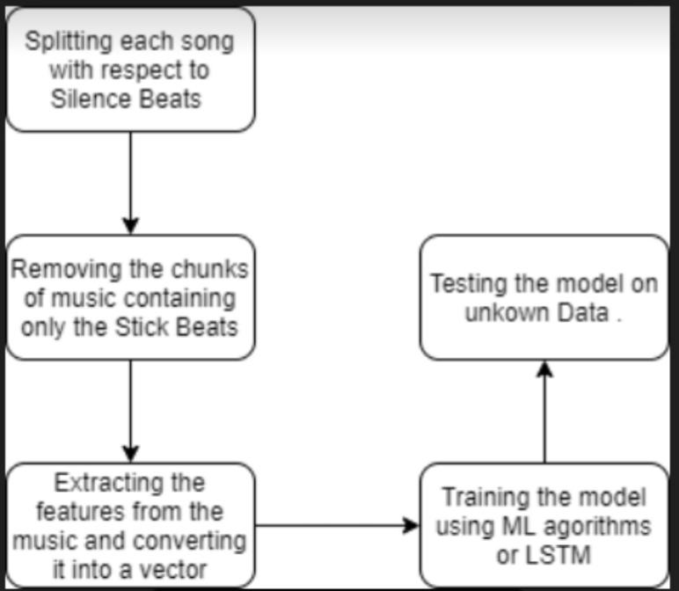
Complete Summary

Slide 18
THANK YOU !
BY K.V.R.K.VIVEK

